Slide 1
Analysing The Impact of Various Factors on Teams’ Performance in IPL 2019
Aditya Patel (17962)
Rahul Kumar Dev (18108)
Soumalya Nandi (18016)
DS 288 : Numerical Methods

Slide 2
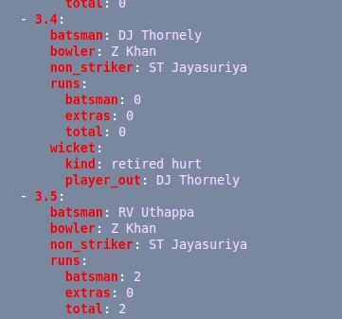



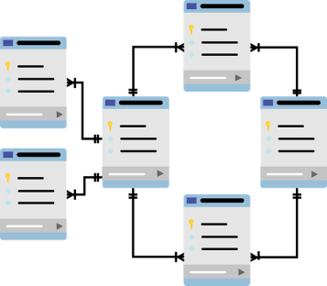

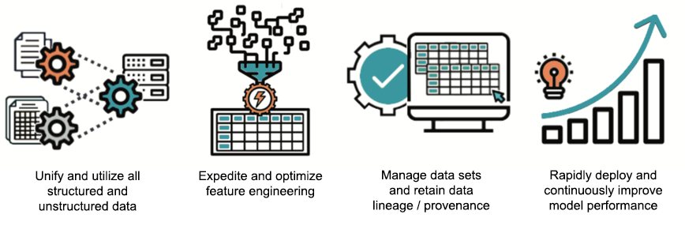
Data Description & Problem Statement
Data Source: https://cricsheet.org/
Match wise Data aggregation
Ball by Ball Data attributes of every IPL match
What are the impacts of the following factors on a session’s outcome?
Toss
Batting Performance
Bowling Performance
Final finding & conclusion
Relational DB creation
2019
EDA and Statistical Analysis
Extraction of Player level features of whole session
2019 session’s data

Slide 3

Methodology & Challenges faced
Methods
EDA
Unsupervised Learning
Inferential Statistics
Visualization
Dynamic Condition of IPL session to session
Various External Factors affecting match
Lack of data to assess the fielding performance
Granularity of the source data

Slide 4


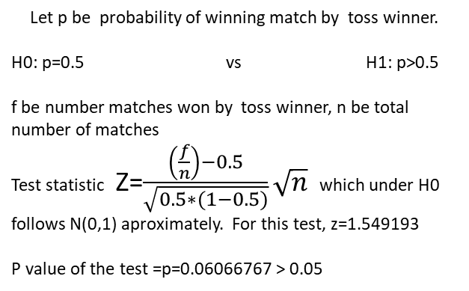
Impact of Toss in 2019
Does winning the toss actually have positive impact in winning the match?
Can not draw inference on the impact of toss!!
Statistical Hypothesis Testing
Let p be probability of winning match by toss winner.
H0: p=0.5 vs H1: p>0.5
f be number matches won by toss winner, n be total number of matches
Test statistic Z=$\frac{\left(\frac{f}{n}\right)−0.5}{\sqrt{0.5∗(1−0.5)}}\sqrt{n}$ which under H0
follows N(0,1) aproximately. For this test, z=1.549193
P value of the test =p=0.06066767 > 0.05
At 95% confidence the null hypothesis can not be rejected.
Failed to conclude that winning the toss have positive impact in winning a match!!!!!!

Slide 5


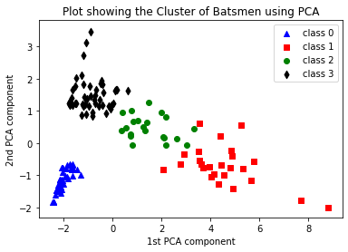
Batting Performance Analysis in IPL 2019
How to choose the best batsmen ?
Clustering
How many clusters to create?
From Elbow Plot
Table showing cluster wise average values of Batting features of players
Features | Cluster 0 | Cluster 1 | Cluster 2 | Cluster 3
Runs | 6.40 | 423.16 | 216.19 | 50.32
Fours | 0.36 | 38.72 | 18.95 | 4.09
Sixes | 0.16 | 18.12 | 8.52 | 2.36
Balls | 8.86 | 299.40 | 161.76 | 37.98
# Fifty | 0 | 3.08 | 0.95 | 0.08
# Hundred | 0 | 0.20 | 0.05 | 0
Strike Rate | 52.34 | 143.18 | 134.58 | 147.30
Out | 1.58 | 11.52 | 7.38 | 2.81
Average | 3.67 | 39.18 | 32.31 | 17.69
No. of Players | 50 | 25 | 21 | 47
MI and CSK were more dominating in the batting performance

Slide 6
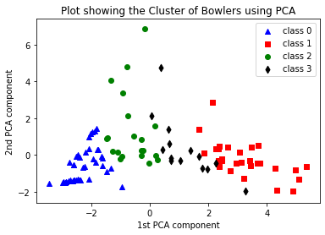
Bowling Performance Analysis in IPL 2019
Table showing cluster wise average values of Bowling features of players
Features | Cluster 0 | Cluster 1 | Cluster 2 | Cluster 3
Balls | 26.40 | 276.36 | 93.40 | 171.07
Wickets | 1.17 | 14.68 | 3.50 | 8.43
Extra | 1.57 | 15.29 | 7.60 | 10.93
Runs | 41.81 | 371.79 | 142.55 | 256.14
# Four | 3.29 | 31.39 | 11.95 | 22.86
# Six | 2 | 14.61 | 6.15 | 9.64
Economy Rate | 10.06 | 8.21 | 9.46 | 9.09
Average | 18.16 | 29.39 | 58.92 | 40.07
Three | 0.05 | 1.36 | 0.15 | 1
Five | 0.02 | 0.04 | 0 | 0
Strike rate | 12.15 | 21.08 | 37.00 | 26.79
No. of Players | 42 | 28 | 20 | 14
MI and CSK were dominating in Bowling performance also

Slide 7



Conclusion
Can not conclude that winning toss helps in winning match.
CSK and MI had the most number of splendid batsmen.
In bowling department also CSK and MI have outperformed other teams.
Cause
Effect
MI & CSK were good with batting
MI & CSK were table toppers
MI & CSK were good with bowling
MI & CSK were the finalists
Performing well in both batting and bowling is the key to have a good IPL session!!!!!

Slide 8
Individual Contribution
Aditya Patel : Project Idea, Data Aggregation, Database Creation
Rahul Kumar Dev : Project Idea, Data Pre processing, Feature Engineering
Soumalya Nandi : Project Idea, Statistical Data Analysis, Visualization

Slide 9
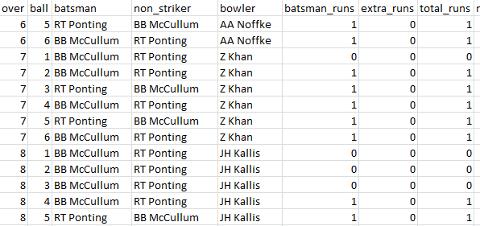
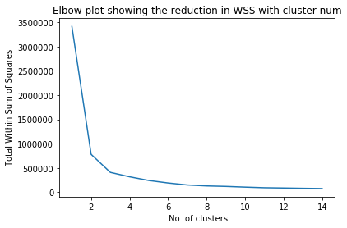
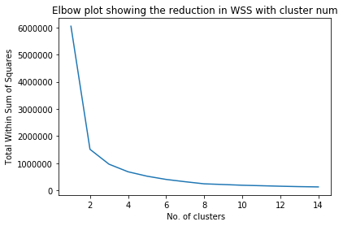
Appendix
Data Snippet in csv format
Variability explained ratio by PCA for bowler
1st PCA : 0.51786309
2nd PCA: 0.1909745
Variability explained ratio by PCA for batsman
1st PCA : 0.62904852
2nd PCA: 0.16531433
Elbow Plot for Bowlers
Elbow Plot for Batsmen

